Slide 1
Notes:
Data location: "C:\Users\gmoran\Dropbox (Grattan Institute)\Health\Quality\Lifting the Lid\Calcs, tables and figures\Breakdown of all complications by all, sameday and multiday.xlsx"

Slide 2
Post-procedural complications
Gastrointestinal complications
Metabolic disorders
Cardiovascular complications
Childbirth complications
Other
Jan 2013
Jan 2014
Jan 2015
Notes:
Data location: "Z:\Programs\Health\Reports Subs and projects\January effect\January effect - chart data - updated 120118.xlsx“ and "C:\Users\gmoran\Dropbox (Grattan Institute)\Health\Quality\MCHADx_time_series2_Greg_new.xls"

Slide 3
Infections
Notes:
Data location: ‘Various HAC stats.xlsx’

Slide 4
Not considered a priority complication
38,471
Notes:
Data location: "C:\Users\gmoran\Dropbox (Grattan Institute)\Health\Quality\Lifting the Lid\Calcs, tables and figures\Minor CHADx and HACs frequencies and comparison_Greg.xlsx"

Slide 5
10.7
REDO
CHADx only
Notes:
Data location: "C:\Users\gmoran\Dropbox (Grattan Institute)\Health\Quality\Lifting the Lid\Calcs, tables and figures\DO NOT USE - Scope for improvement (no outlier removal) - Greg.xlsx"

Slide 6
10.7
Other complications only
Notes:
Data location: "C:\Users\gmoran\Dropbox (Grattan Institute)\Health\Quality\Lifting the Lid\Calcs, tables and figures\Scope for improvement (no outlier removal) - Greg.xlsx"

Slide 8
Notes:
Data location: "C:\Users\gmoran\Dropbox (Grattan Institute)\Health\Quality\Lifting the Lid\Calcs, tables and figures\MCHADx box plot Greg.xlsx"

Slide 9
Actual rate
DO NOT USE
Notes:
Data location: "C:\Users\gmoran\Dropbox (Grattan Institute)\Health\Quality\Lifting the Lid\Calcs, tables and figures\DO NOT USE - Differences in MCHADx at hospital level.xlsx"

Slide 10
Actual rate
Notes:
Data location: "C:\Users\gmoran\Dropbox (Grattan Institute)\Health\Quality\Lifting the Lid\Calcs, tables and figures\Differences in MCHADx at hospital level.xlsx"

Slide 11
Random variation

Slide 12
All multiday non-obstetric
Notes:
"C:\Users\gmoran\Dropbox (Grattan Institute)\Health\Quality\Lifting the Lid\Calcs, tables and figures\Comparing subsamples GREG.xlsx"

Slide 13
DO NOT USE
SA
ACT, NT, TAS
Private sector
Notes:
"C:\Users\gmoran\Dropbox (Grattan Institute)\Health\Quality\Lifting the Lid\Calcs, tables and figures\DO NOT USE - cardiac_state_comparison.xlsx"

Slide 14
SA
ACT, NT, TAS
Private sector
Notes:
"C:\Users\gmoran\Dropbox (Grattan Institute)\Health\Quality\Lifting the Lid\Calcs, tables and figures\cardiac_state_comparison.xlsx"

Slide 15
DO NOT USE

Slide 16
Average excess risk (per cent)
Annual reduction in admissions with complications if hospitals had same excess risk as best decile
Worst decile hospitals
DO NOT USE
Middle performers
Best decile hospitals
Notes:
Data location: "C:\Users\gmoran\Dropbox (Grattan Institute)\Health\Quality\Lifting the Lid\Calcs, tables and figures\DO NOT USE - Excess complications cardiology Greg.xlsx"

Slide 17
Average excess risk (per cent)
Annual reduction in admissions with complications if hospitals had same excess risk as best decile
Worst decile hospitals
Middle performers
Best decile hospitals
Notes:
Data location: "C:\Users\gmoran\Dropbox (Grattan Institute)\Health\Quality\Lifting the Lid\Calcs, tables and figures\Excess complications cardiology Greg.xlsx"

Slide 18
Knee replacement
All multiday non-obstetric
With complications
Notes:
Data location: "C:\Users\gmoran\Dropbox (Grattan Institute)\Health\Quality\Lifting the Lid\Calcs, tables and figures\LOS_by_subsample_complete - Greg.xlsx“
NOTE: the dots are from Lucille’s graph but the averages are from Greg’s data (although they are the same to one decimal point as Lucille’s). The file "C:\Users\gmoran\Dropbox (Grattan Institute)\Health\Quality\Lifting the Lid\Calcs, tables and figures\Updated LOS with and without MCHADx1.xlsx“ contains a comparison of Lucille and Greg’s data to demonstrate that there were no material differences therefore it was fine to use Lucille’s dots

Slide 19
50-64 years old
Hospital B

Slide 20
Best quintile
2nd quintile
3rd quintile
4th quintile
Worst quintile
Data not available to Grattan
Overall performance
Notes:
"C:\Users\gmoran\Dropbox (Grattan Institute)\Health\Quality\Lifting the Lid\Calcs, tables and figures\Expected and observed mCHADx rates_nonobstetric_MD_sample_GREG.xls"

Slide 21
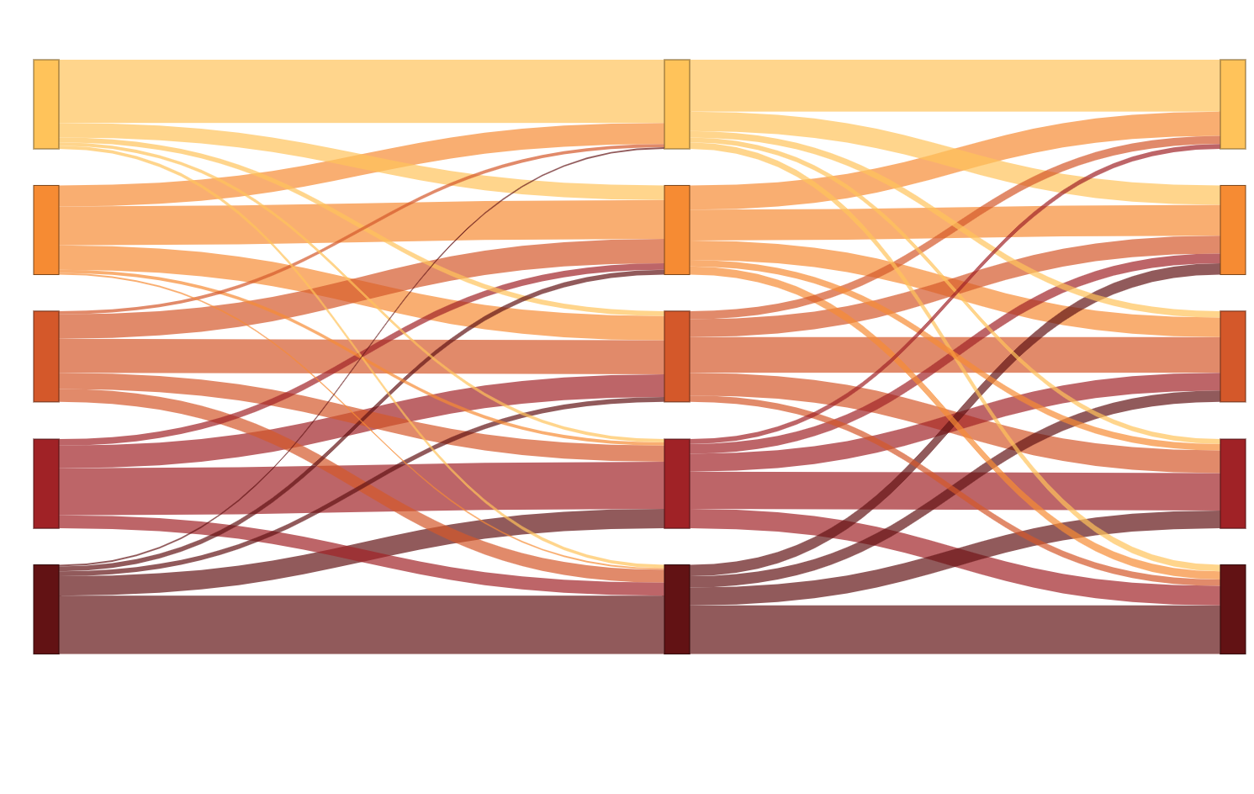
Safest 20% of hospitals
Least-safe 20% of hospitals
FY 2012-13
FY 2013-14
FY 2014-15

Slide 22
Original data format
Initial admissions
Linked readmissions
Expanded data format
Initial admissions
Linked readmissions
Expanded data format, after removing empty observations
Non-empty initial admissions
Non-empty linked readmissions

Slide 23
VIC
Notes:
State coding depth.xlsx

Slide 24
VIC
Notes:
State coding depth.xlsx

Slide 25
Medical cardiology
Knee replacement
Bariatric surgery
Multiday non-obstetric
Sameday non-obstetric
Obstetric

